Slide 1
Predicting Corporate Bankruptcy: A Statistical Learning Approach
Statistical Learning 22/23
Karim Hamdar Christian Bustos Davide Mazza

Slide 2
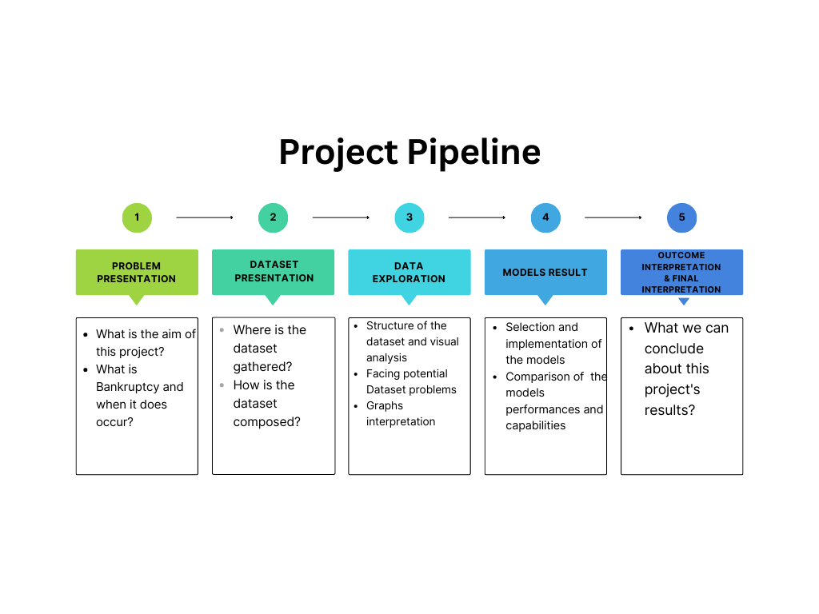

Slide 3

Problem Presentation

Slide 4

Bankrupcty
Credit risk and corporate bankruptcy are significant topics in finance and business.
Corporate bankruptcy occurs when a company is financially insolvent, unable to meet its obligations.

Slide 5

Effects:
Business failure has far-reaching consequences, including financial losses, unemployment, and systemic instability.

Slide 6

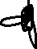
Modern approaches:
Predicting bankruptcy is crucial for financial institutions, investors, and stakeholders.
Statistical models and machine learning algorithms offer new possibilities for bankruptcy prediction

Slide 7


Compustat dataset by S&P
The Compustat dataset is a widely utilized source of financial information for companies.
It provides extensive coverage of publicly traded companies in the United States and Canada.
Maintained and provided by S&P Global, a leading provider of financial market intelligence.

Slide 8

Bankruptcy Dataset
The bankruptcy dataset contains 5436 observations each of these representing a different company.
For each company we have 13 variables, 10 of them are financial ratios which will be our tool for bankruptcy classification.
These variables derived by the balance sheet provide insights into various financial aspects of the companies.

Slide 9

Ratios
Accounting Variables:
R1: WC/TA (Working Capital/Total Assets)
R2: RE/TA (Retained Earnings/Total Assets)
R3: EBIT/TA (Earnings Before Interest and Tax/Total Assets)
R4: ME/TL (Market Value of Equity/Total Liability)
R5: S/TA (Sales/Total Assets)
R6: TL/TA (Total Liability/Total Assets)
R7: CA/CL (Current Assets/Current Liability)
R8: NI/TA (Net Income/Total Assets)
R9: Bankruptcy cost, Log(sales)
Market Variables:
R10: Market capitalization

Slide 10


Remaining variables
CUSIP: Committee on Uniform Securities Identification Procedures code
FYEAR: Categorical variable representing the year of data collection
Target variable:
DLRSN: Binary variable indicating bankruptcy (0 = No Bankruptcy; 1 = Bankruptcy)

Slide 11
Data analysis

Slide 12
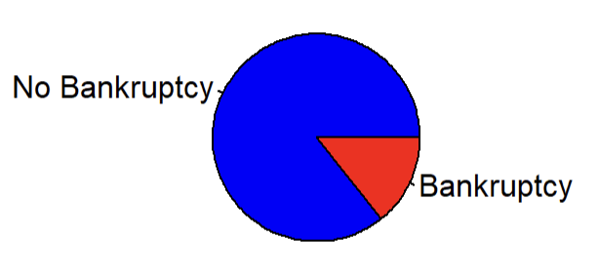
Data exploration
…unbalanced dataset!
No NA values or duplicate values, no need to clean or filter the dataset
No bankruptcy | Bankruptcy
85.72% | 14.28%

Slide 13
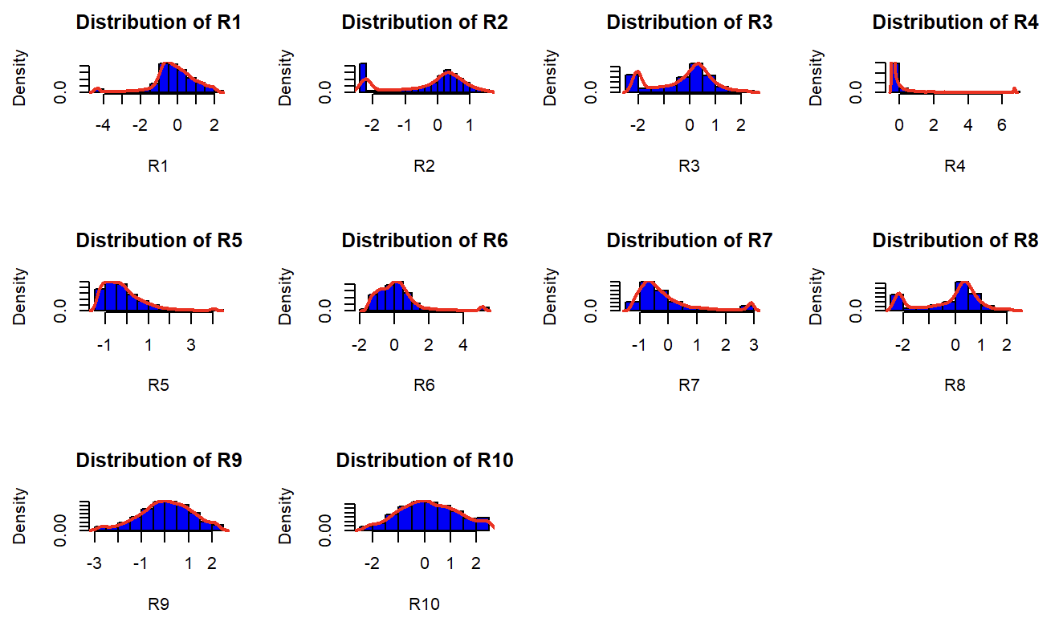
Univariate Analysis
Variables’s distribution

Slide 14
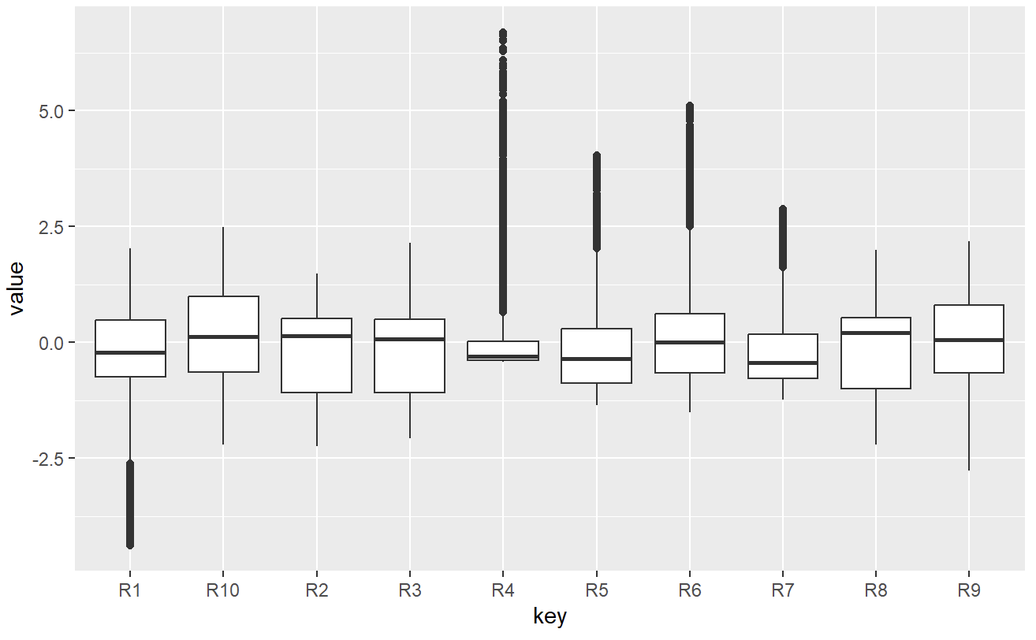
Univariate Analysis
Variables’s boxplot

Slide 15
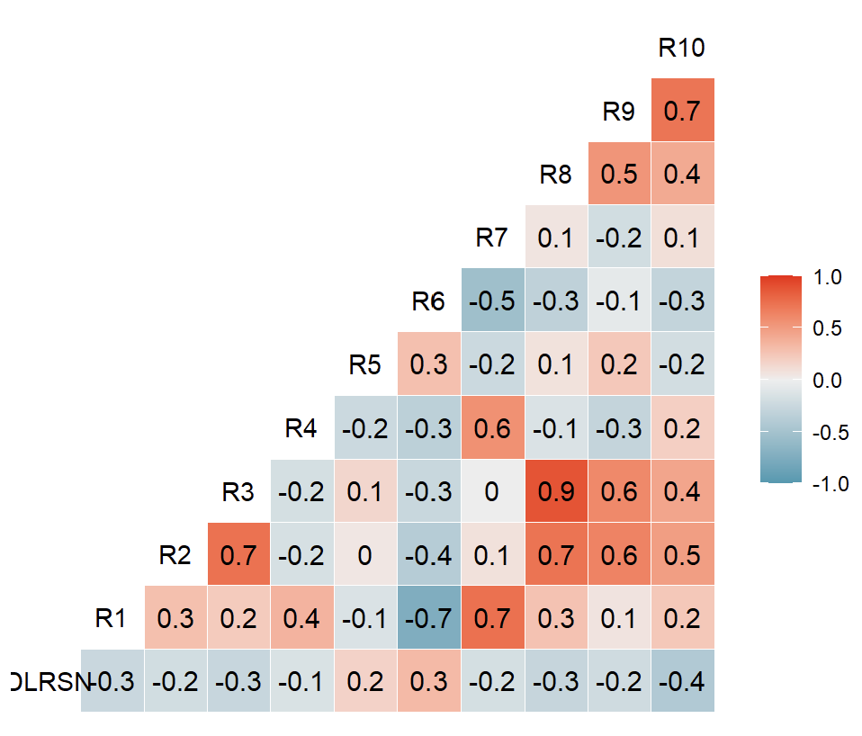

Bivariate Analysis
Confusion matrix

Slide 16
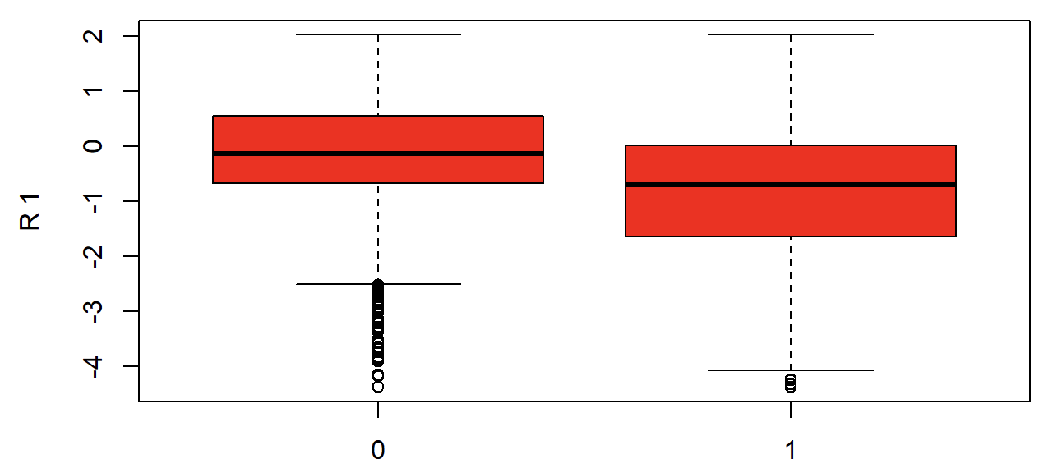
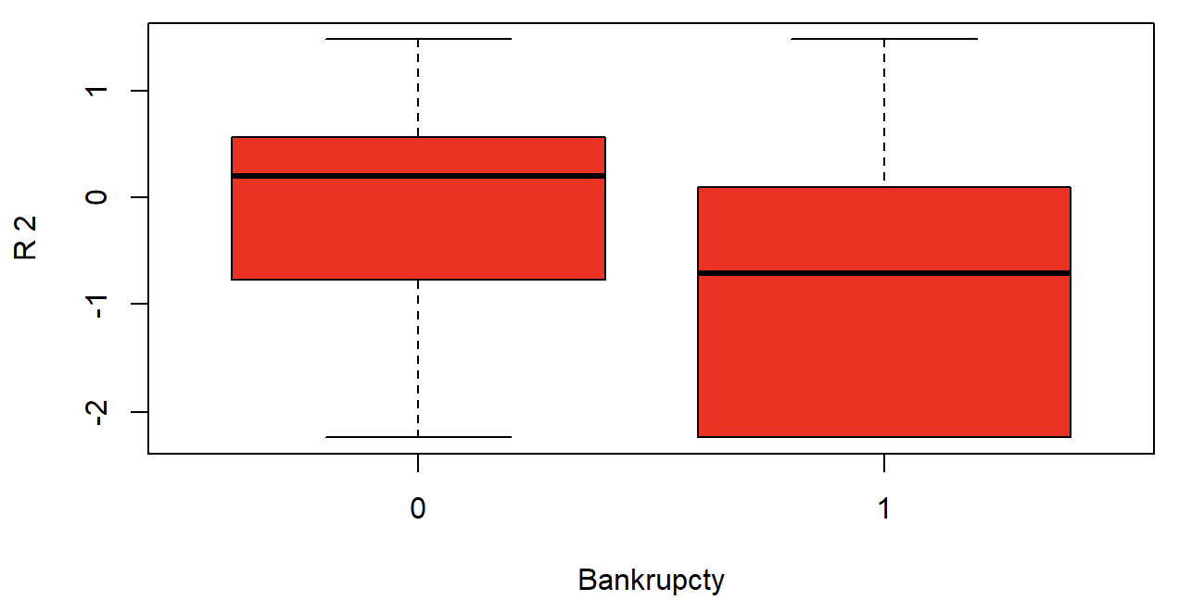
Boxplots
R1
R2

Slide 17
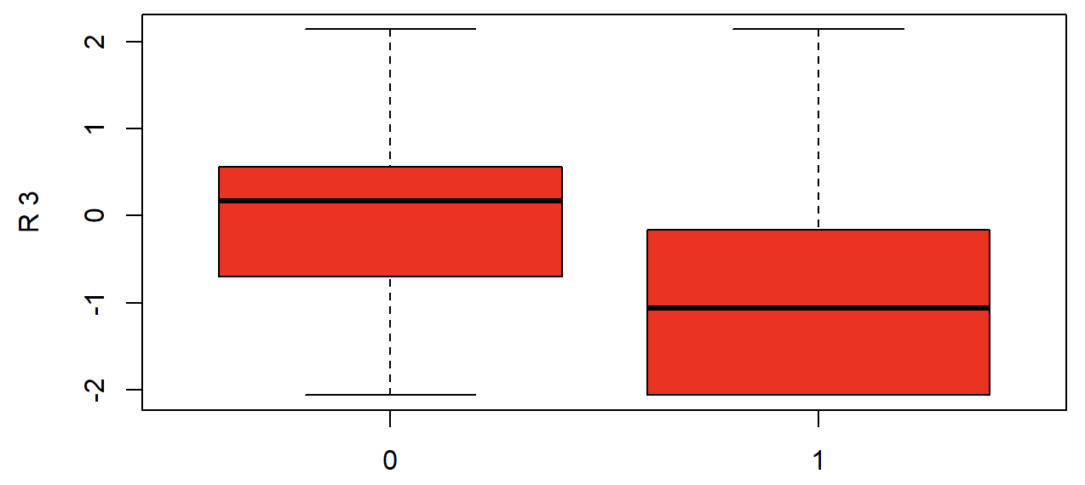
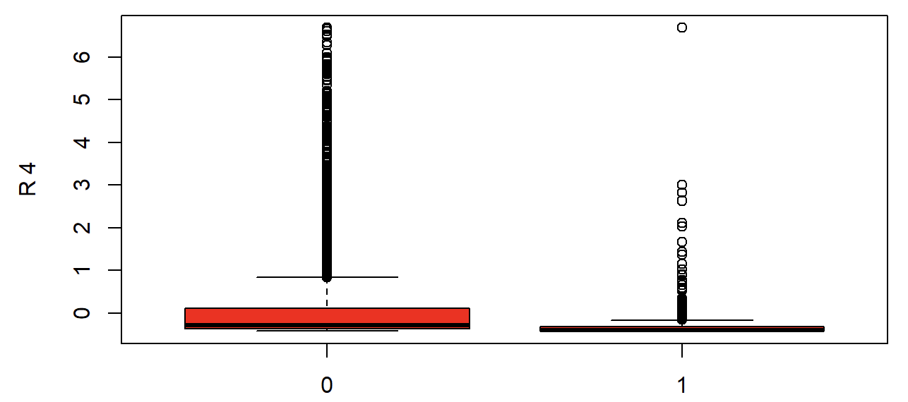
Boxplots
R3
R4

Slide 18
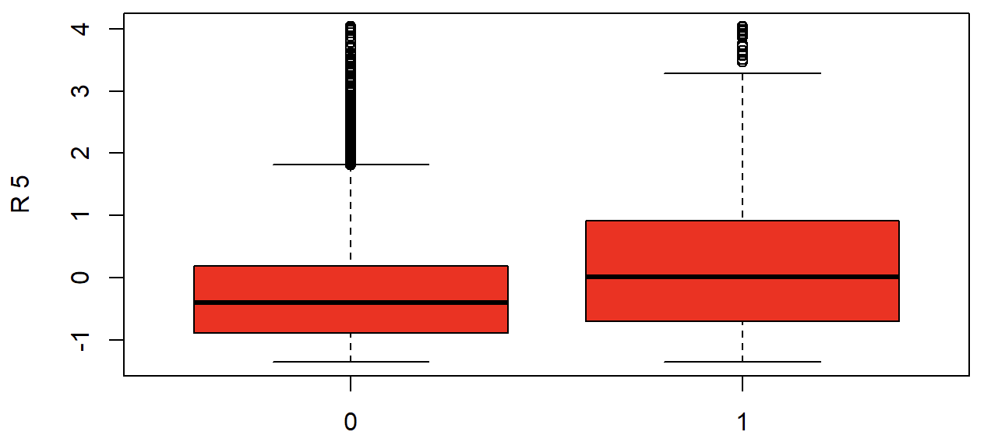
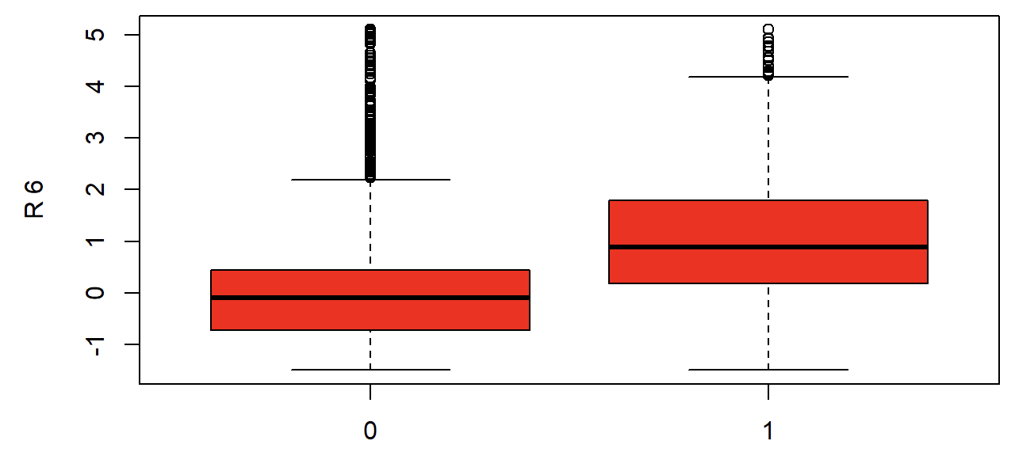
Boxplots
R5
R6

Slide 19
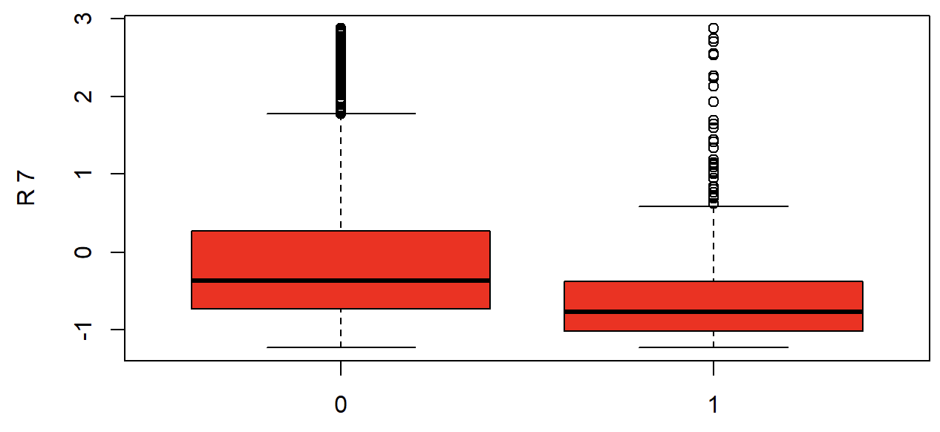
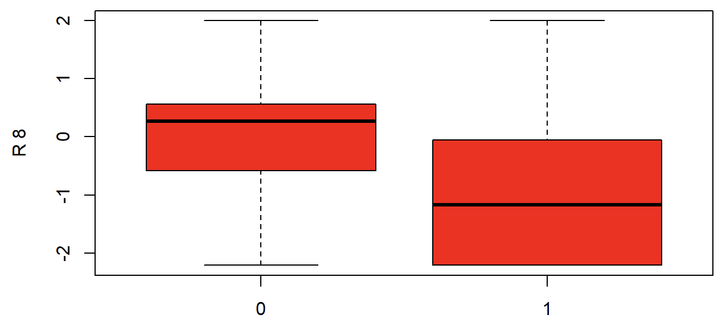
Boxplots
R7
R8

Slide 20
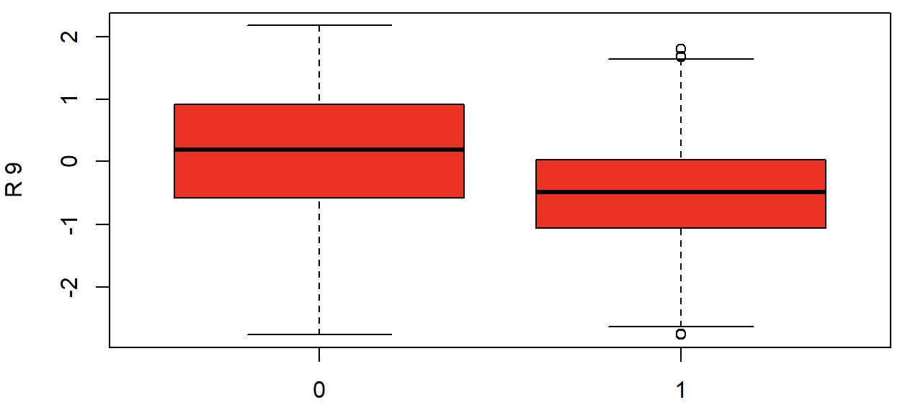
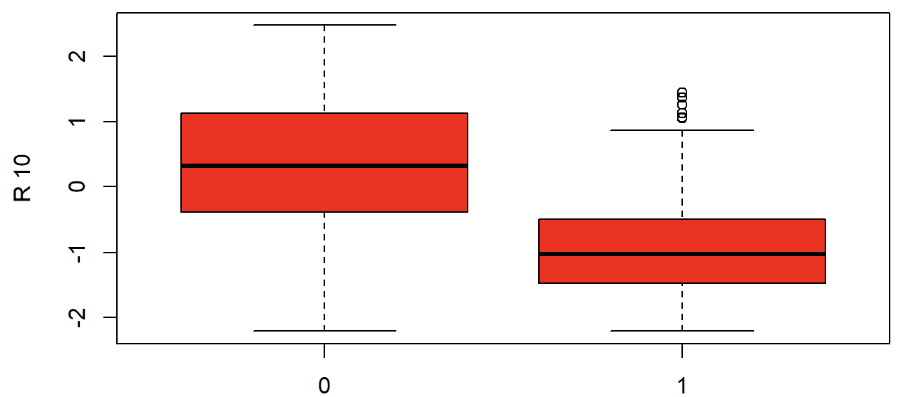
Boxplots
R9
R10

Slide 21
Prediction Models

Slide 22
Model data
Logistic regression models:
Complete Logistic Regression model
Logistic with Stepsize Selection (Backwards elimination; Forward selection)
Balanced logistic model
Balanced logistic model with Stepwise Selection (Backward Balanced; Forward Balanced)
Shrinkage methods (Ridge & Lasso Regression)
Linear Discriminant Analysis (LDA)
K-NN
Bayes Classifier
Data-set splitting Training set is made up by 75% of the original dataset

Slide 23
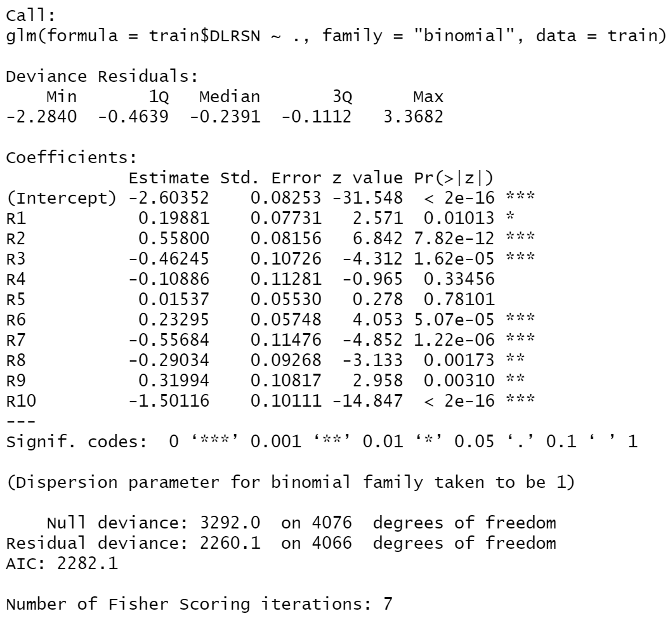
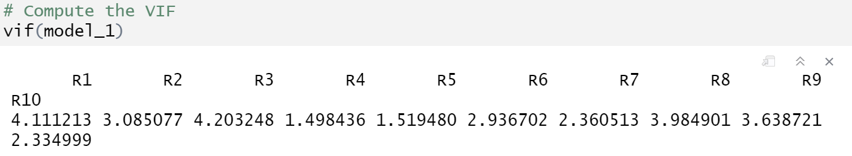
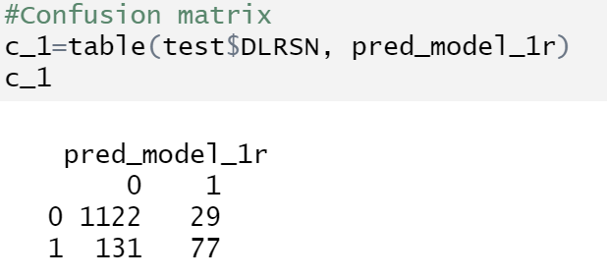
Complete Logistic Regression model
R4: Market Value of Equity / Total Liability
R5: Sales / Total Asset
Accuracy: 0.8822664
Sensitivity: 0.3701923

Slide 24
Intepretation of coefficients
R1 = 0.19881
Odds Ratio ≃ exp(0.19881) ≃ 1.219
R1=Working Capital / Total Asset
R10 = log(price) * # shares outstanding/1000
R10 = -1.500116
Odds Ratio ≃ exp(-1.500116) ≃ 0.222

Slide 25
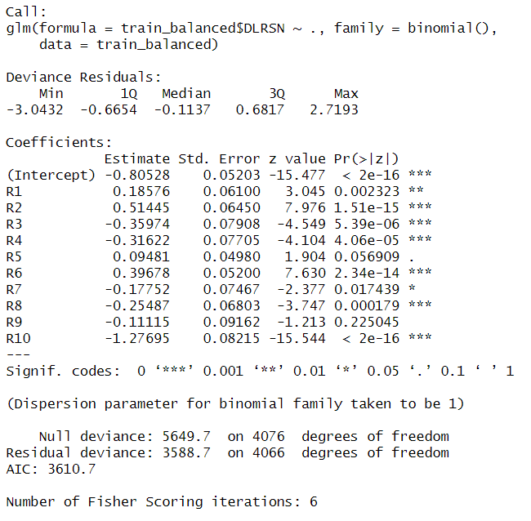
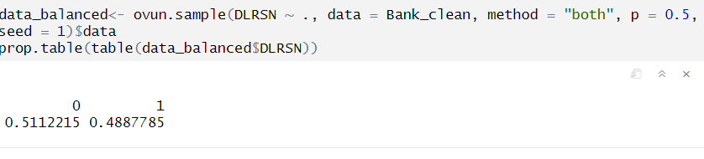
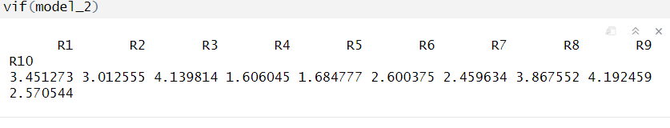
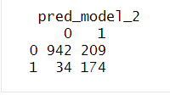
Balanced Logistic Regression Model
Accuracy: 0.8211921
Sensitivity: 0.8365385
R9: log(SALE)

Slide 26
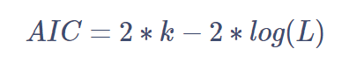
Logistic with Stepsize Selection (Backwards elimination; Forward selection)
where: k= # of parameters and L=maximum value of likelihood function computed on the model. The lower the AIC, the better is the model.
Based on choice of the initial model, there are two distinct procedures:
Forward selection: we start with the Null model.
Backwards elimination: we start with the Complete model.

Slide 27
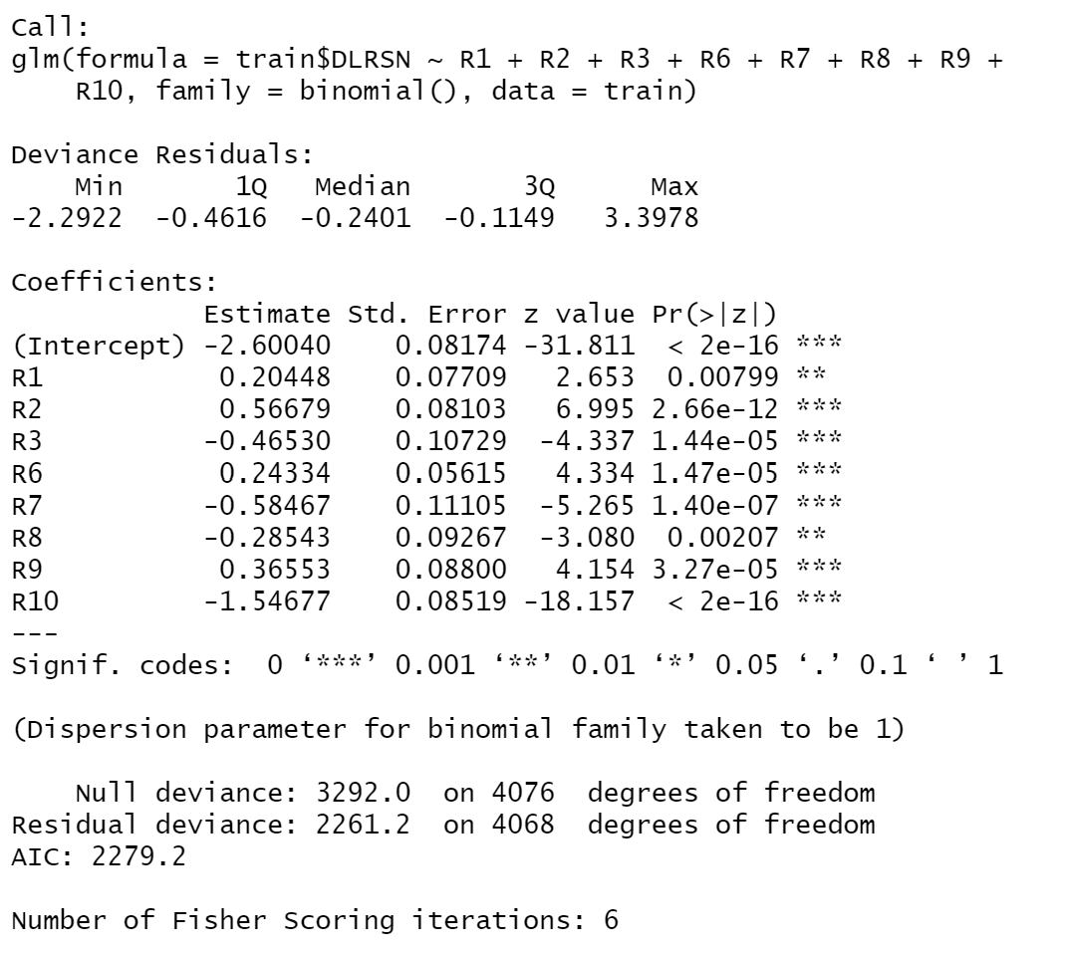
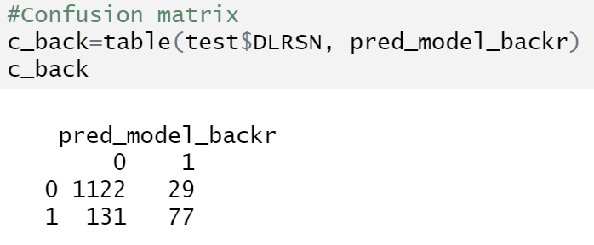
Backwards elimination
Accuracy: 0.8822664
Sensitivity: 0.3701923

Slide 28
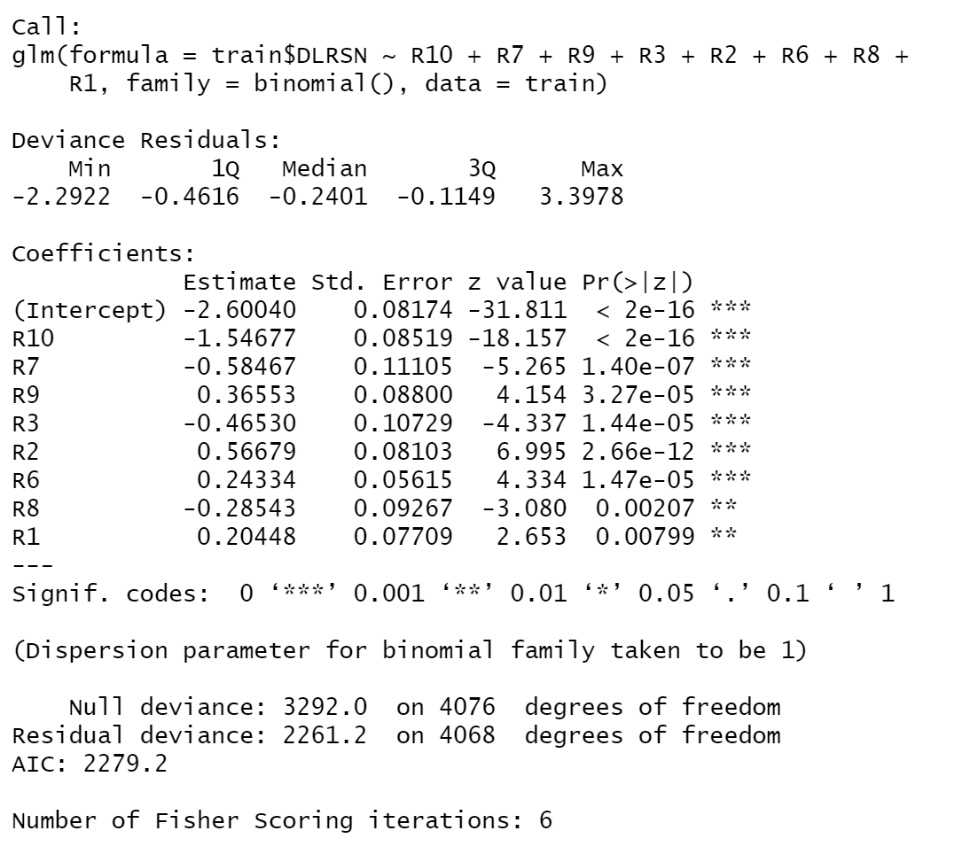
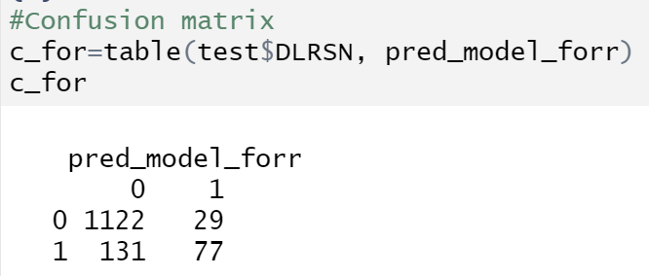
Forward selection
Accuracy: 0.8822664
Sensitivity: 0.3701923

Slide 29
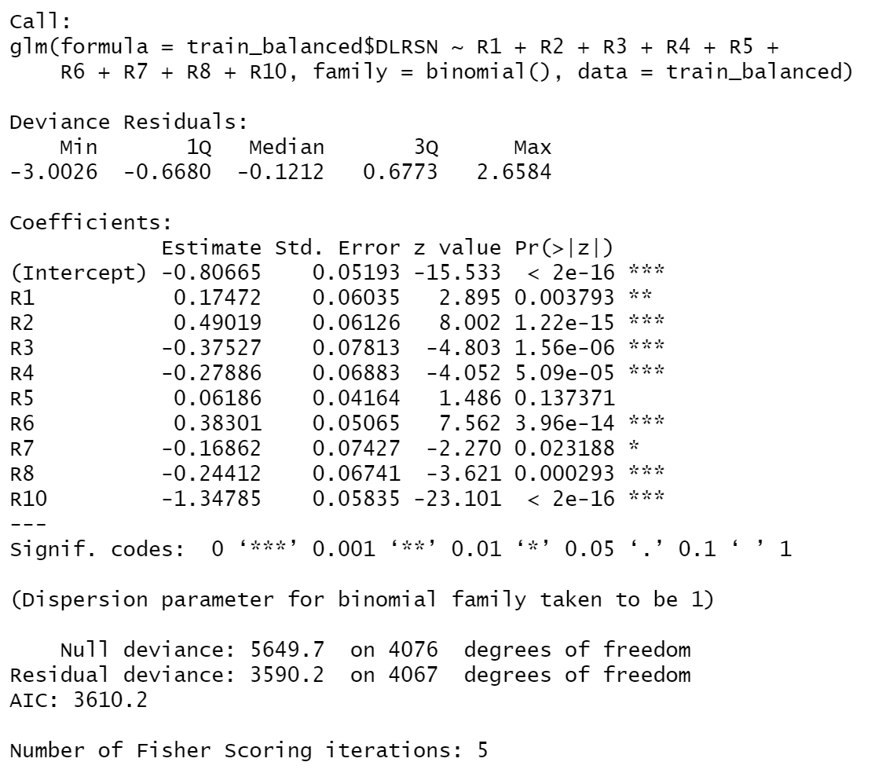
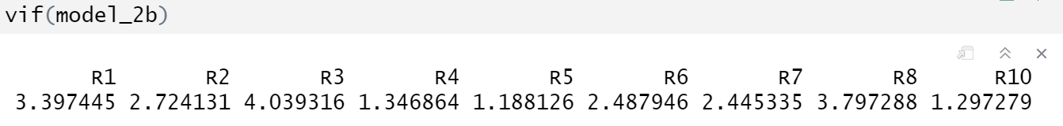
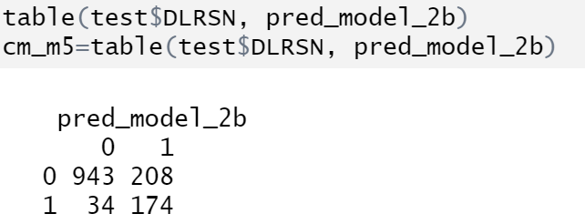
Backward Balanced
Accuracy: 0.8219279
Sensitivity: 0.8365385

Slide 30
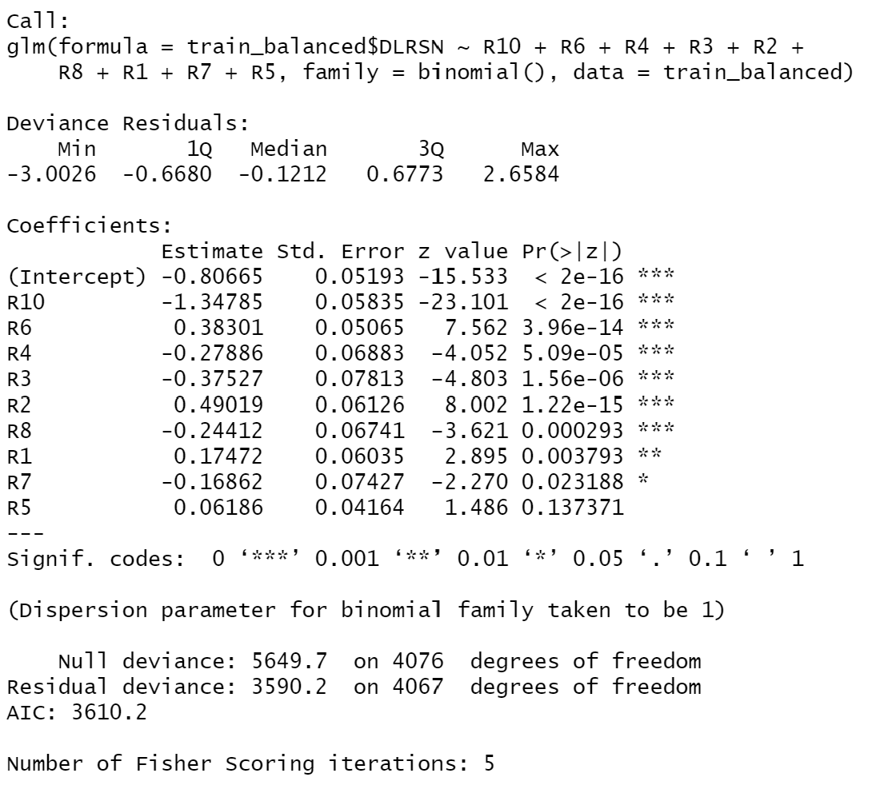
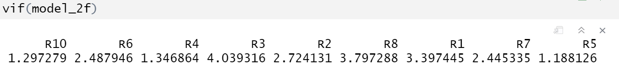
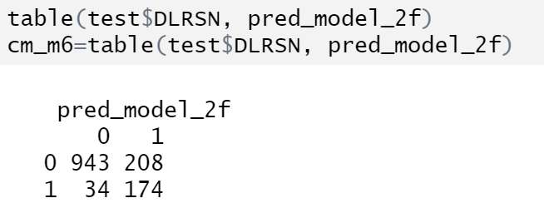
Forward Balanced
Accuracy: 0.8219279
Sensitivity: 0.8365385

Slide 31
Shrinkage methods
Shrinkage methods are a group of statistical techniques used to
improve the performance of predictive models by reducing the impact of noisy or less informative features.
In particular:
Ridge Regression model, quadratic shrinkage.
Lasso Regression model, absolute value shrinkage.

Slide 32
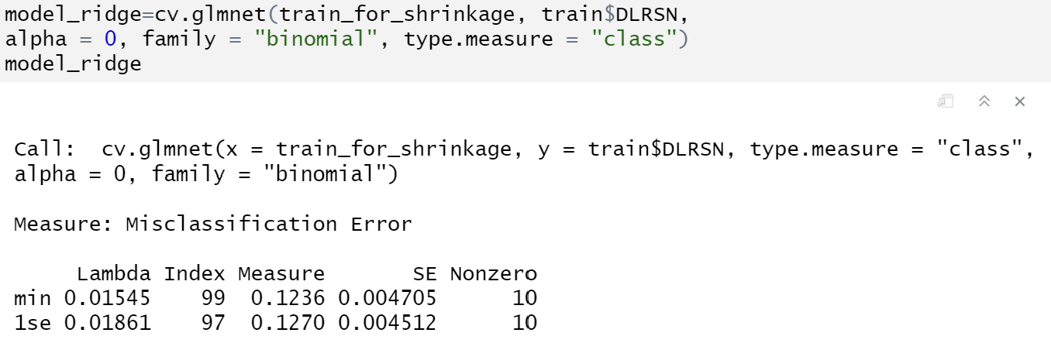
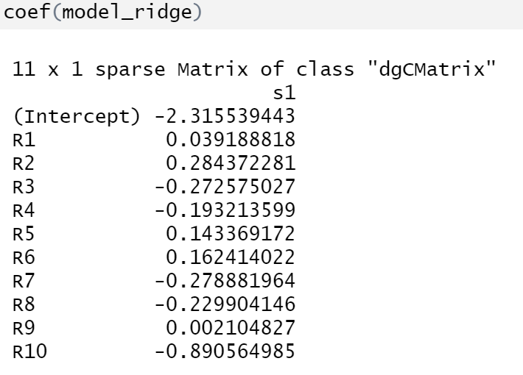
Shrinkage methods: Ridge Regression

Slide 33
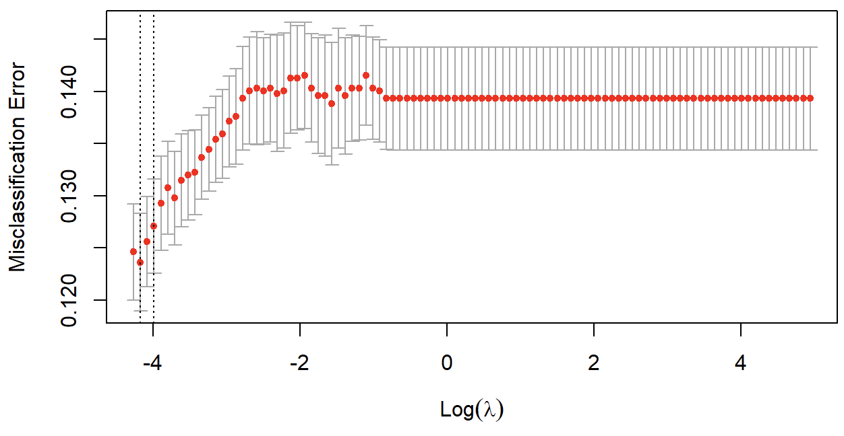
Misclassification error for Ridge Regression given log lamba value

Slide 34
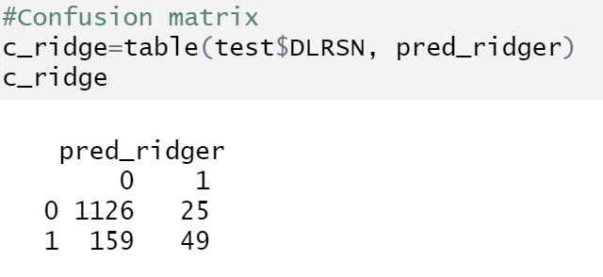
Ridge Regression: Confusion Matrix
Accuracy: 0.8646063
Sensitivity: 0.2355769

Slide 35
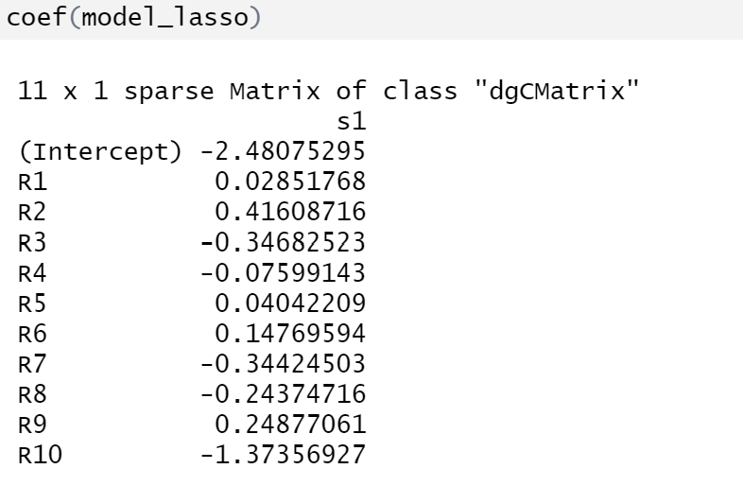
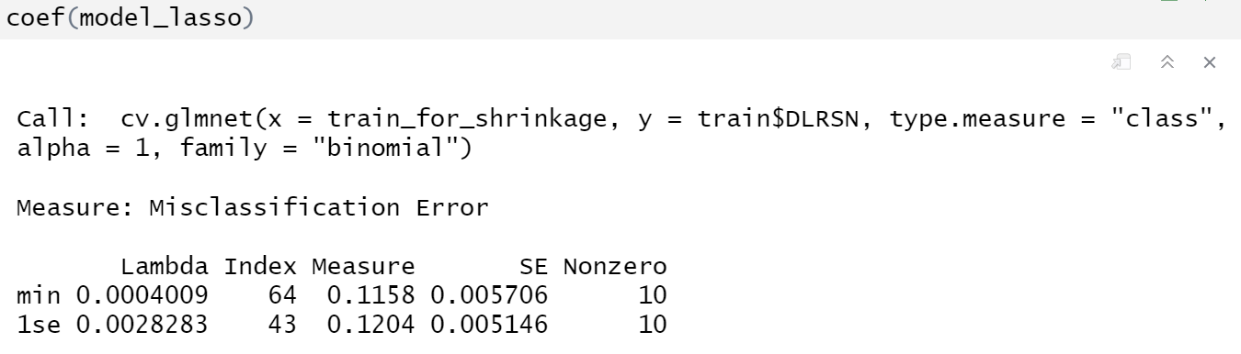
Shrinkage methods: Lasso Regression

Slide 36
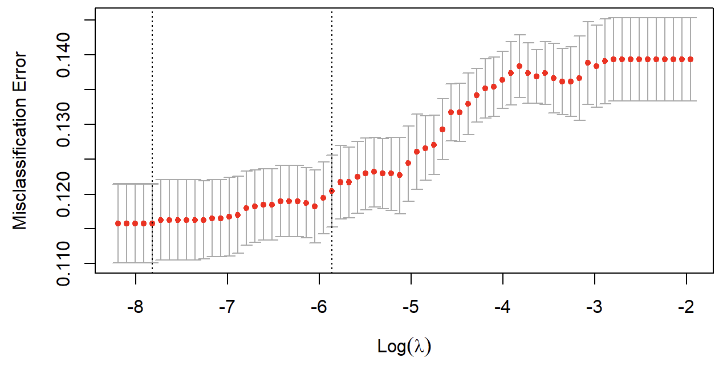
Misclassification error for Ridge Regression given log lamba value

Slide 37
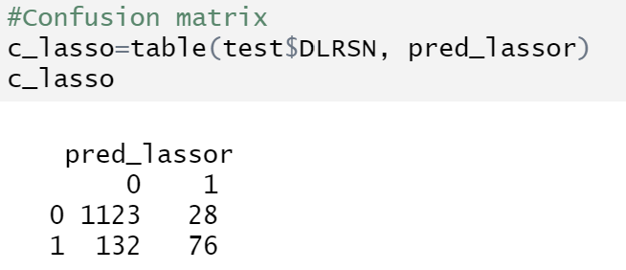
Lasso Regression: Confusion Matrix
Accuracy: 0.8822664
Sensitivity: 0.3653846

Slide 38
Table of contents:
LDA
QDA
K-NN
The Naive Bayes model
ROC
Metric comparisons and Conclusions

Slide 39

Linear Discriminant Analysis (LDA): assumptions
Linearly Separated Classes: LDA assumes that the classes can be separated by linear boundaries.
Multivariate Normality: LDA performs best when the sample size is small and predictor distributions in each class are approximately normal.
Homoscedasticity: LDA assumes that all covariates have the same variance.
Independence of Predictors: LDA works best with independent predictor variables.

Slide 40
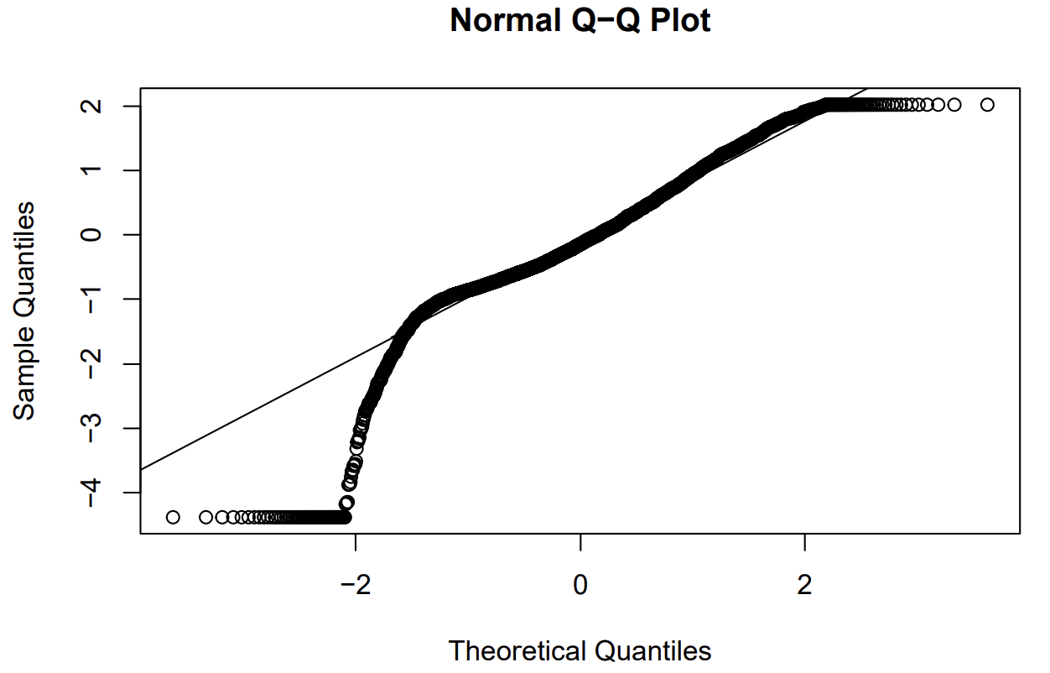
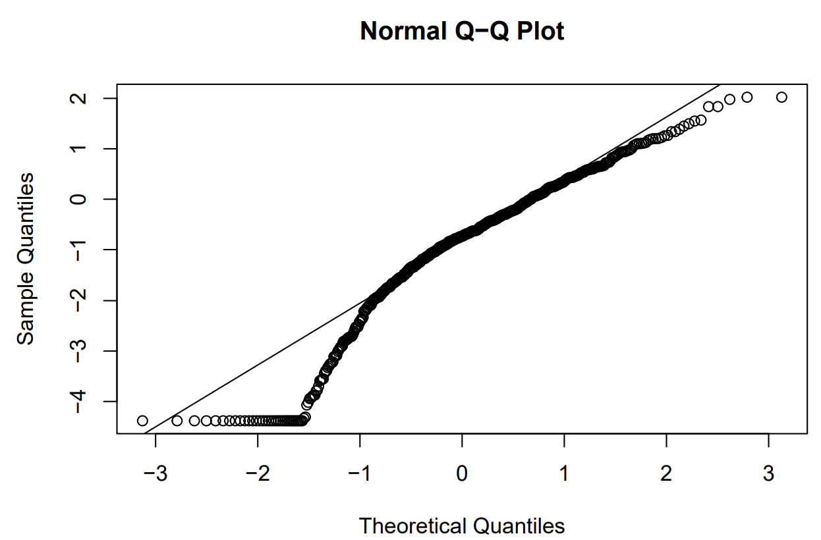
Linear Discriminant Analysis (LDA): Normality check
R1
No Bankruptcy
Bankruptcy

Slide 41
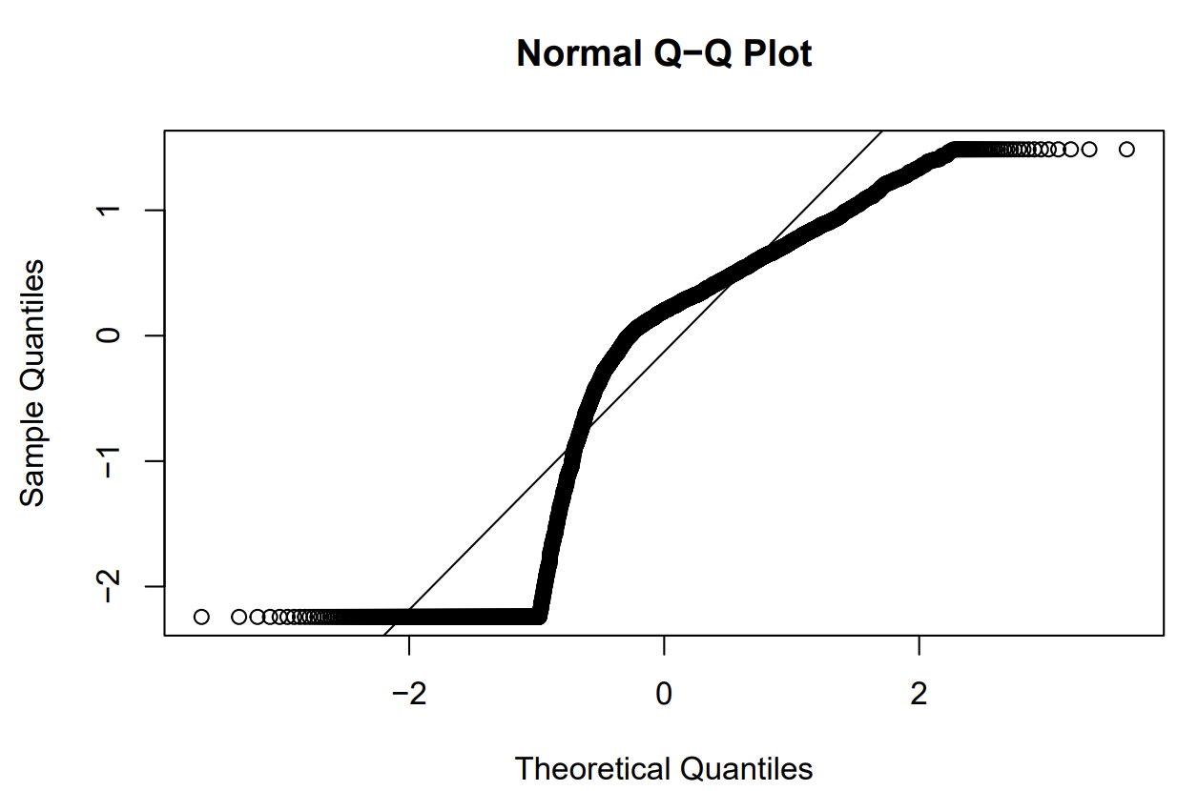
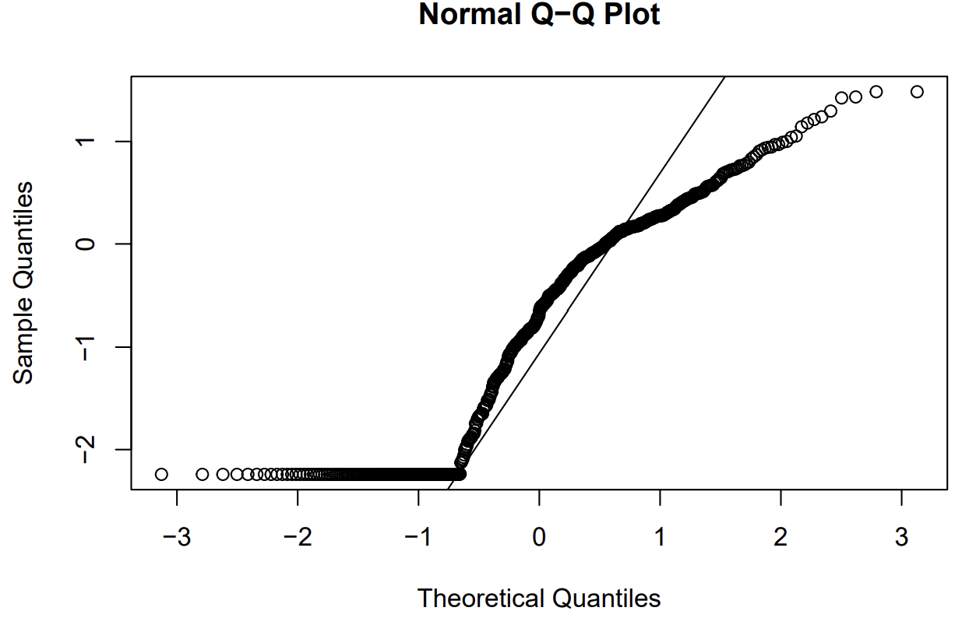
Linear Discriminant Analysis (LDA): Normality check
R2
No Bankruptcy
Bankruptcy

Slide 42
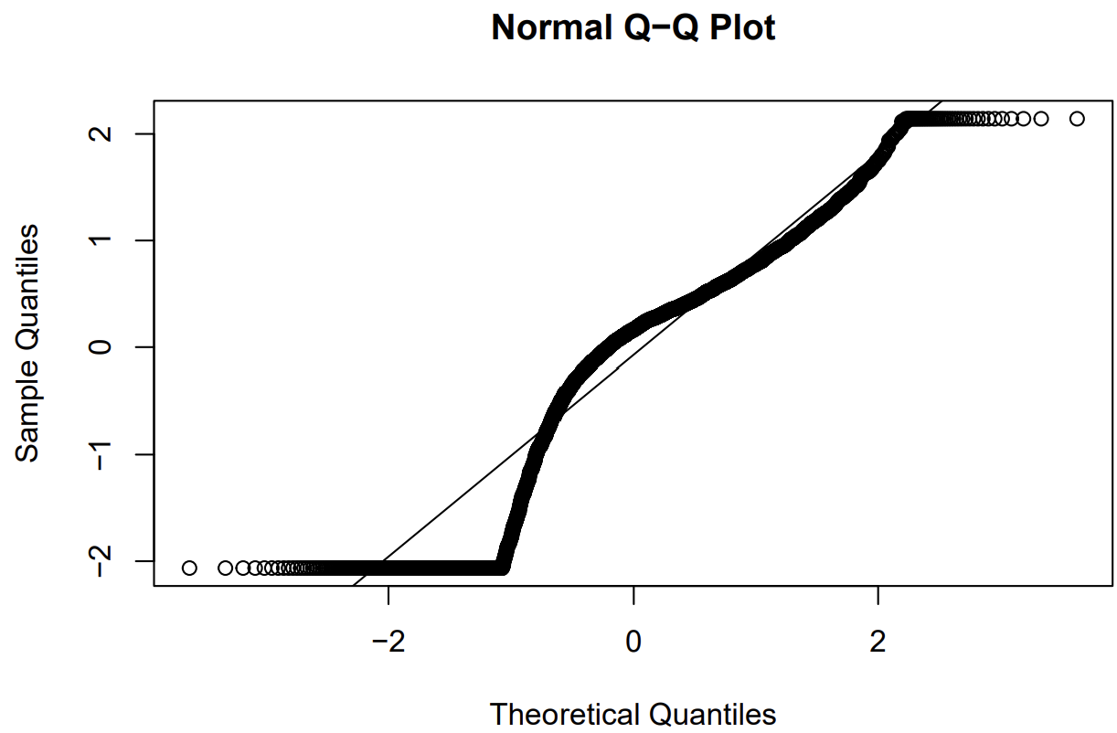
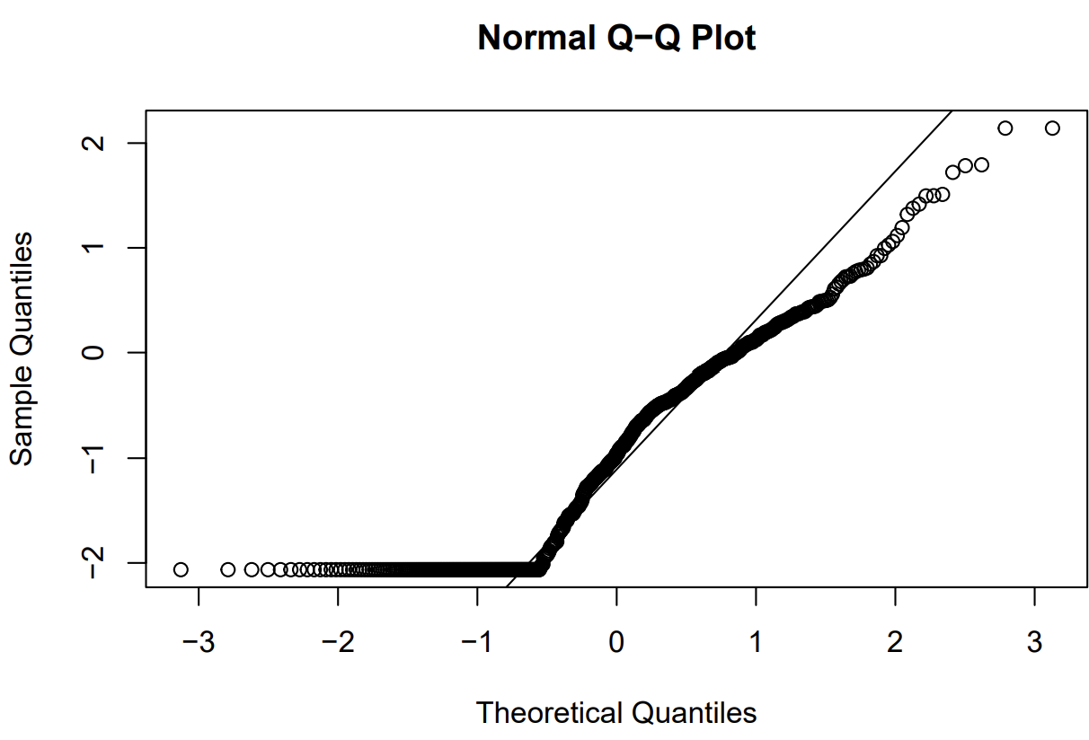
Linear Discriminant Analysis (LDA): Normality check
R3
No Bankruptcy
Bankruptcy

Slide 43
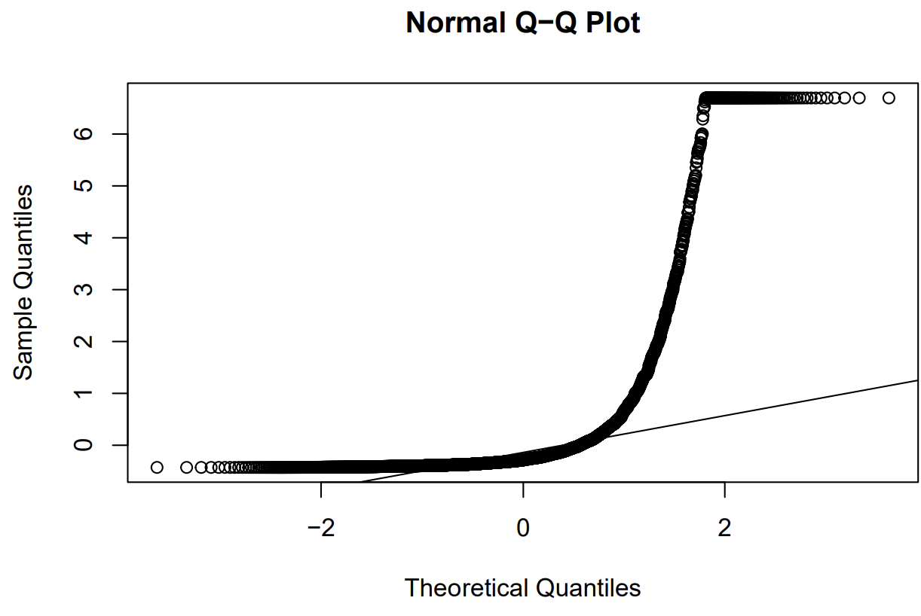
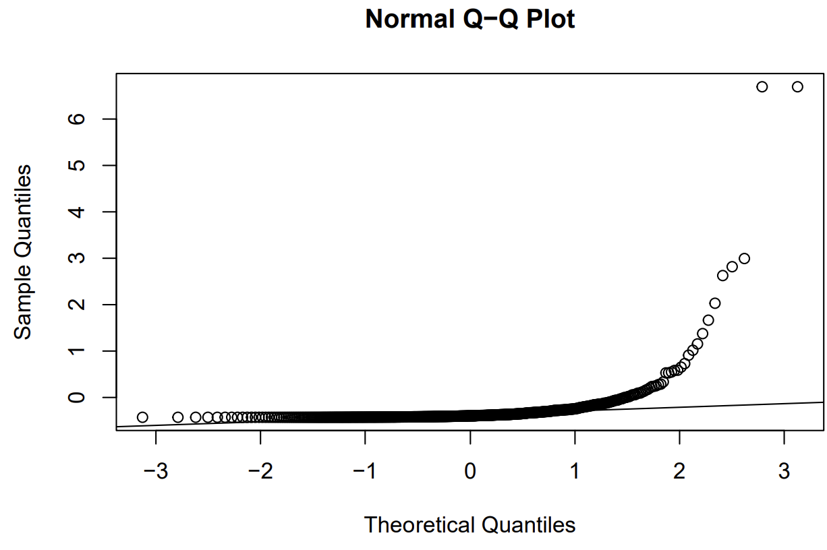
Linear Discriminant Analysis (LDA): Normality check
R4
No Bankruptcy
Bankruptcy

Slide 44


Linear Discriminant Analysis (LDA): Normality check
R5
No Bankruptcy
Bankruptcy

Slide 45


Linear Discriminant Analysis (LDA): Normality check
R6
No Bankruptcy
Bankruptcy

Slide 46


Linear Discriminant Analysis (LDA): Normality check
R7
No Bankruptcy
Bankruptcy

Slide 47


Linear Discriminant Analysis (LDA): Normality check
R8
No Bankruptcy
Bankruptcy

Slide 48


Linear Discriminant Analysis (LDA): Normality check
R9
No Bankruptcy
Bankruptcy

Slide 49


Linear Discriminant Analysis (LDA): Normality check
R10
No Bankruptcy
Bankruptcy

Slide 50

Linear Discriminant Analysis (LDA): Normality check
Distributions of R9 and R10:
R9 and R10 exhibit a perfect fit with the normal distribution.
Their distributions align well with the Gaussian curve, indicating a good match to the assumption of multivariate normality.
Distributions of R4, R6, and R7 :
In contrast, R4, R6, and R7 do not fit the Gaussian curve optimally.
However, it's important to note that overall, we can be satisfied with the multivariate normality concerning our variables.

Slide 51

Outliers Detection and Elimination
Variable | # of Outliers
R1 | 190
R2 | 0
R3 | 0
R4 | 553
R5 | 140
R6 | 117
R7 | 197
R8 | 383
R9 | 0
R10 | 0
To detect outliers, we employ the interquartile rule (IQR)
We identified outliers (data points that fall above or below a specific range relative to the IQR) for variables R1, R4, R5, R6 ,R7 and R8, as we saw earlier during the univariate analysis of the variables through boxplots. After this operation1591 observations are excluded. From now on we are gonna use train_wo_out.

Slide 52


LDA Procedure
Accuracy: 0.794702
Sensitivity: 0.6057692

Slide 53


Quadratic Discriminant Analysis
Accuracy: 0.8344371
Sensitivity: 0.7259615

Slide 54



K-NN
Visually we can see that from K=55 K-NN produces both best accuracy and best sensitivity.

Slide 55

The Naive Bayes model
It is a probabilistic classifier that estimates the probability of an instance belonging to a class based on certain attributes.
It applies Bayes' theorem to make predictions, leveraging conditional probabilities.
It assumes that the attributes are conditionally independent of each other, given the class value (this simplifying assumption makes the calculations more efficient).
The model utilizes Bayes' theorem to calculate the conditional probability of an instance belonging to a particular class.
It predicts the class for a given instance based on the class with the highest conditional probability.
It selects the class that has the highest likelihood of generating the observed attribute values.
Results:
Accuracy: 0.8425313
Sensitivity: 0.7259615

Slide 56

Model Comparison ROC Curve
AUC Logistic (Balanced): 0.8274786
AUC Logistic (with all features): 0.8918624
AUC Naive Bayes Classifier: 0.7947792
AUC Linear Discriminant Analysis (LDA): 0.8078469
AUC Quadratic Discriminant Analysis (QDA): 0.8376328
AUC Ridge Regression: 0.8937254
AUC Lasso Regression: 0.892347

Slide 57


Metrics Comparison
Based on the metrics, we can group the models into two categories:
High Accuracy, Low Sensitivity:
Complete Logistic Model
Ridge Regression Model
Lasso Regression Model
High Accuracy, High Sensitivity:
Balanced Logistic Model
Bayes Classifier Model
LDA Model
QDA Model
55-NN

Slide 58
Conclusions
Bankruptcy is a complex phenomenon influenced by multiple factors, rather than a single cause.
Therefore the analysis identified some ratios, including R4 (ME/TL) and R5 (S/TA), which have a relatively weaker impact on predicting bankruptcy compared to other variables.
R4 (ME/TL) measures the market value of equity in relation to total liability. Its lower impact suggests that the market value of equity may not be a significant factor in predicting bankruptcy in the specific dataset.
R5 (S/TA) measures the sales-to-assets ratio. Its lower impact indicates that this ratio may not be a strong predictor of bankruptcy in the analyzed context.

Slide 59


